Slide 1
BizTalk Mapping Patterns and Best Practices
BizTalk User Group Sweden in Gothenburg
Sandro Pereira
Senior Software Developer
Microsoft Azure MVP

Slide 2


Sandro Pereira
Senior Software Developer at DevScope
Microsoft Integration MVP since 2011
Writer of numerous articles for Portuguese eMagazine “Programar”
Author “Sandro Pereira BizTalk Blog” http://sandroaspbiztalkblog.wordpress.com
Member of “BizTalkAdminsblogging.com” and “BizTalk Brasil” community
Member NetPonto community
MSDN BizTalk Forums Moderator
TechNet Wiki author (Wiki Ninja)
TechNet Gallery, Code Gallery and CodePlex contributor
Public speaker
Technical Reviewer PACKT Publishing
BizTalk Server 2010 Cookbook (April 2012)

Slide 3






Good afternoon….
Sandro Pereira
Senior Software Developer | Microsoft Azure MVP
sandro.pereira@devscope.net
linkedin.com/in/sandropereira
@sandro_asp
sandroaspbiztalkblog.wordpress.com
+351 223 751 350
www.devscope.net
Notes:
My name is Sandro Pereira and I’m working as a BizTalk Consultant at DevScope in Portugal an amazing company and I’m a Microsoft Integration MVP since 2011
Writer of numerous articles for Portuguese eMagazine “Programar”
Author “Sandro Pereira BizTalk Blog” http://sandroaspbiztalkblog.wordpress.com
Member of “BizTalkAdminsblogging.com” and “BizTalk Brasil” community
Member NetPonto community
MSDN BizTalk Forums Moderator
TechNet Wiki author (Wiki Ninja)
TechNet Gallery, Code Gallery and CodePlex contributor
Public speaker
Technical Reviewer PACKT Publishing
BizTalk Server 2010 Cookbook (April 2012)

Slide 4


12 Mapper Patterns
365 pages
4 Technical Reviewers
Steef-Jan Wiggers, Nino Crudele, Michael Stephenson, José António Silva
FREE BOOK! Or you can buy a physical copy for £10
http://www.biztalk360.com/biztalk-mapping-patterns/
BizTalk Mapping Patterns and Best Practices
Sandro Pereira
brought to you by
Notes:
Last year I told here that I was writing a book about Mapping Patterns… It is a pleasure to say that the book is already available for free… almost 400 pages about mapping so I hope if you have not done so go there download it and hope you enjoy

Slide 5




Mikael Håkansson
I will proudly wear Pepe jersey in Integration 2017 London… Best defender ever!

Slide 6
Agenda
How BizTalk Mapper Works
Best Practices
BizTalk Mapper Patterns
Common mapper problems and solutions

Slide 7
Basics Considerations
Important basic considerations and what new improvements

Slide 8
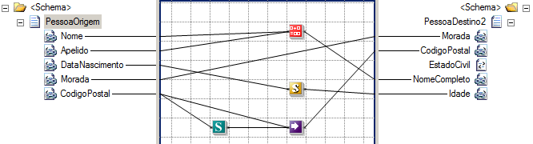
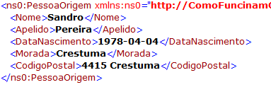
Transformation types
Syntax
Semantics
CSV → XML
←→ Bidirectional
Schema → Schema
→ One-way (typically)
Notes:
Syntax Transformations: This type of transformations occurs in the receive or send pipelines and aim to transform a document into another representation, e.g. CSV to XML. Here the document maintains the same data (semantics), but changes the syntax that is represented. I.e. we translate the document, but typically we don't modify the structure. Normally, this type of transformation is bidirectional, since we still have the same semantic content, we can apply the same transformation logic and obtain the document in its original format.
Data Translation
Change the format of data between messages
Example: translate between a flat file and an XML file
Semantic Transformations: This type of transformation usually occurs only in BizTalk maps. Here the document maintains the same syntax that is represented (XML), but changes its semantics (data content). This type of transformation are typically one-way, since that when we added and aggregate small parts of the information, that compose the document into another differently document, we may miss important details for its reconstruction.
Data Transformation
Perform computational and other data operations
Copy the data from one message to another

Slide 9
What Is a BizTalk Map?
A map defines the correspondence between records, elements and fields in two different schemas
Data Translation
Change the format of data between messages
Example: translate between a flat file and an XML file
Map
Source Schema
Destination Schema
Record
Order
PO
PO Number
Status
Date
Data Transformation
Perform computational and other data operations
Copy the data from one message to another
ItemID
Item No
Qty
Quantity
UnitPrice
Order Status
Date
Total Price
Page 1
Notes:
BizTalk map. A file that defines the correspondence between the records and fields in one schema and the records and fields in another schema. BizTalk maps are implemented in XML Extensible Stylesheet Language Transformations (XSLT).
Extensible Stylesheet Language Transformations (XSLT). An industry-standard specification defined by the World Wide Web Consortium (WC3) for expressing transformations between two documents. The XSLT generated by BizTalk is fully W3C compliant.

Slide 10
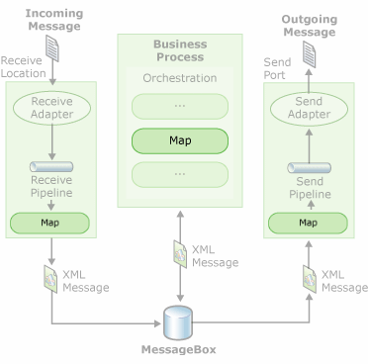
Where can be used?
Maps can be used in
Receive Locations
Send ports
Inside Orchestrations
Notes:
The biggest difference between using maps in ports or in orchestrations is that, when we use maps inside orchestrations we can have multiple messages inputs (transformations of many documents into one final document – transformations N←→1) and ports only allows a single input message (transformations 1←→1).

Slide 11
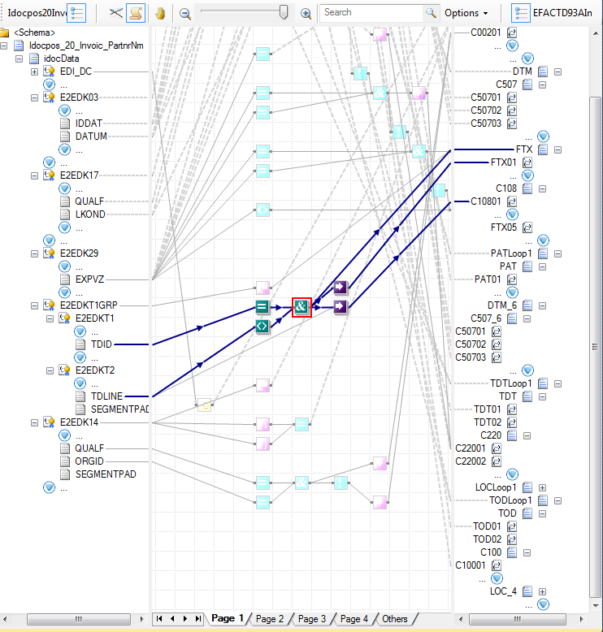
New Mapper in BizTalk Server 2010
Better UI for complex or large transformations
Reduce background “noise” using highlight propagation
Auto-scrolling and sibling coalescing help locate nodes
Enhanced functionality
Support for search
Improved productivity with cut/copy/paste/move/ undo
Predictive match
Improved support for documenting map and readability

Slide 12
BizTalk Server 2013 Improvements
Performance enhancements
The Mapper uses the XSLCompiledTransform class. Previous BizTalk Server versions used the XslTransform class, which is obsolete. The XSLCompiledTransform class provides performance enhancements, including:
Once the Load method completes successfully, the Transform method can be called simultaneously from multiple threads.
The new XSLT processor compiles the XSLT style sheet to a common intermediate format. Once the style sheet is compiled, it can be cached and reused.

Slide 13
How BizTalk Mapper Works
How maps are processed internally by the engine of the product as we explore the map editor BizTalk Server.

Slide 14
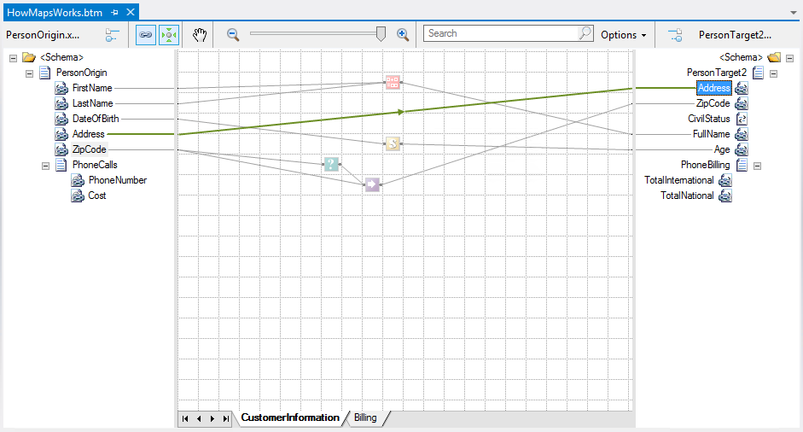
Deconstructing a map
<Address>
<xsl:value-of select="Address/text()" />
</Address>
Notes:
Basically on this mapping problem there are two similar schemes, which we intend to map the source elements in their proper destination and for which we implemented the following challenges:
Concatenate the first and last name in order to give the full name (Concatenation of values);
Map the Address in its destination element (Direct copy)
Transform the date of birth in age (Custom scripts);
The Zip Code should only be mapped if it has a valid string, otherwise it will not be mapped (Conditional selection);
The element Civil Status is optional and as we have no evidence in the source to map it, it should be ignored (Add new values).
Additionally, we perform a more advanced mapping logic to calculate the total of national and international calls using cycles, conditional selections and mathematical operations.
The first element found is "Address"; Since there is link associated to this element, the link is translated by one XPath expression (”Address/text()”) that defines the element to be extracted from the source

Slide 15
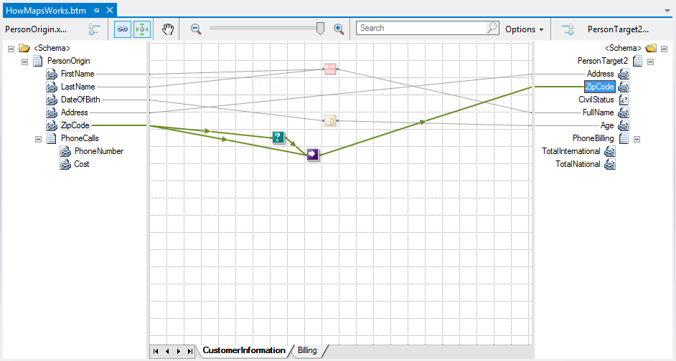
Deconstructing a map
<xsl:variable name="var:v1" select="userCSharp:LogicalExistence(boolean(ZipCode))" />
<xsl:if test="string($var:v1)='true'">
<xsl:variable name="var:v2" select="ZipCode/text()" />
<ZipCode>
<xsl:value-of select="$var:v2" />
</ZipCode>
</xsl:if>
Notes:
The second element found is “ZipCode” also with a link associated; It is a conditional selection that will be translated into a XSLT condition (xsl:if):

Slide 16
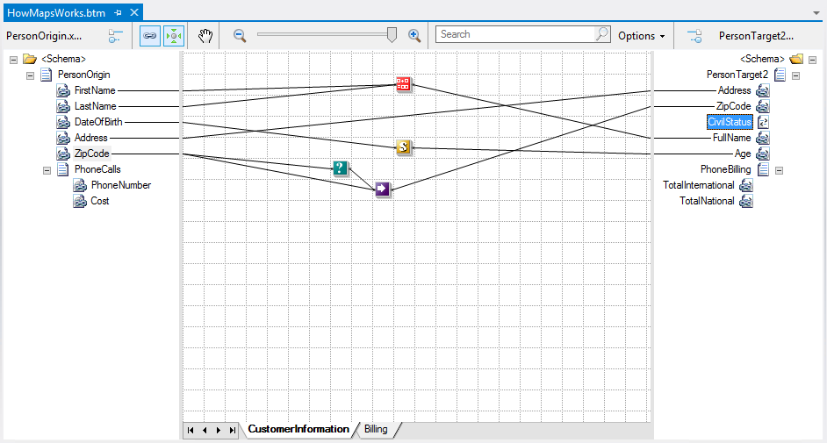
Deconstructing a map
Notes:
The third element is "CivilStatus", since there are no links associated with this element, it is ignored in the mapping process

Slide 17
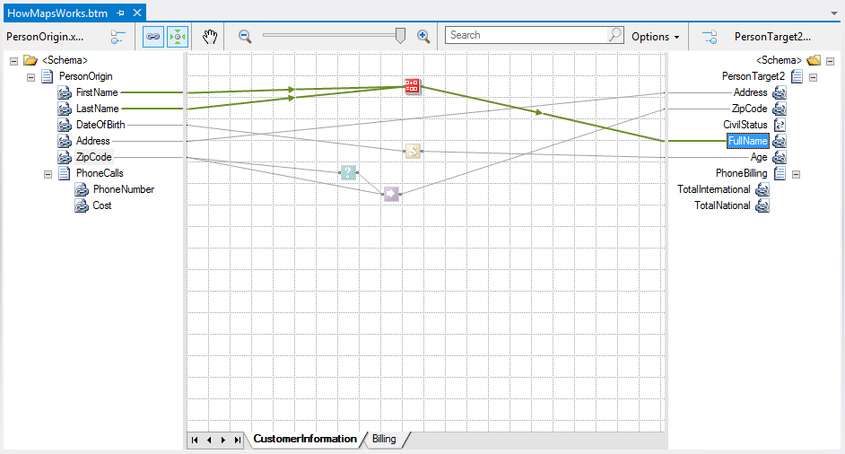
Deconstructing a map
<xsl:variable name="var:v3" select="userCSharp:StringConcat(string(LastName/text()) , ", " , string(FirstName/text()))" />
<FullName>
<xsl:value-of select="$var:v3" />
</FullName>
Notes:
The fourth element to be processed is “FullName” and once again there is a link associated, which corresponds to the concatenation of two elements of the origin; If you check the generated code, is assigned to the element "FullName" the value of variable “$var:v3” that is generated from the execution of the function userCSharp:StringConcat that visually represents the String Concatenate Functoid:

Slide 18
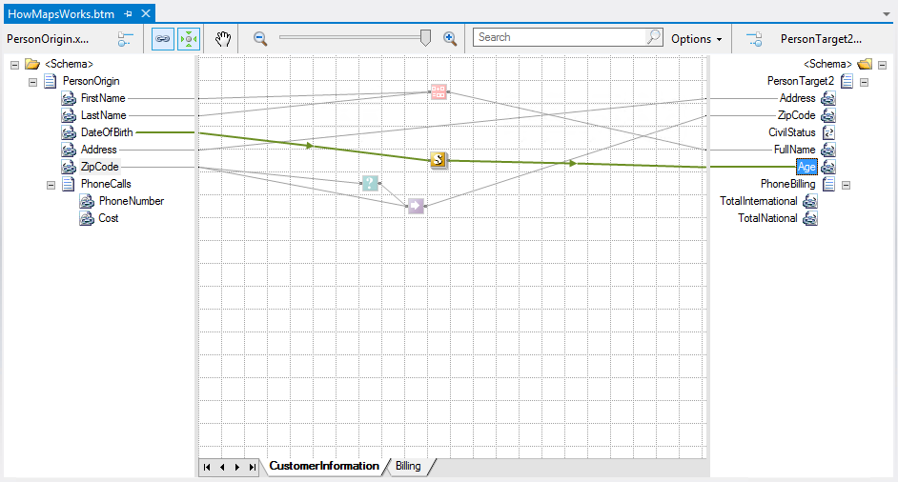
Deconstructing a map
<xsl:variable name="var:v4" select="userCSharp:CalculateMyAge(string(DateOfBirth/text()))" />
<Age>
<xsl:value-of select="$var:v4" />
</Age>
Notes:
The fifth element is “Age”, a link is found which means that custom script found inside the CSharp Inline Scripting Functoid will be carried out:

Slide 19
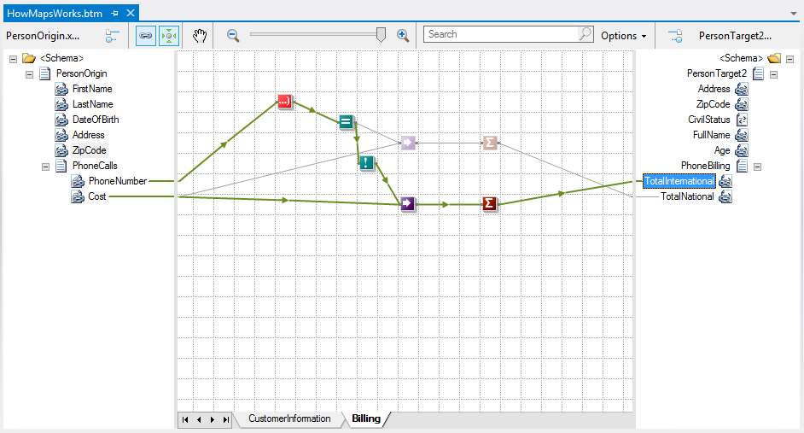
Deconstructing a map
<xsl:variable name="var:v5" select="userCSharp:InitCumulativeSum(0)" />
<xsl:for-each select="/s0:PersonOrigin/PhoneCalls">
<xsl:variable name="var:v6" select="userCSharp:StringLeft(string(@PhoneNumber) , &quot;4&quot;)" />
<xsl:variable name="var:v7" select="userCSharp:LogicalEq(string($var:v6) , &quot;+351&quot;)" />
<xsl:variable name="var:v8" select="userCSharp:LogicalNot(string($var:v7))" />
<xsl:if test="string($var:v8)='true'">
<xsl:variable name="var:v9" select="@Cost" />
<xsl:variable name="var:v10" select="userCSharp:AddToCumulativeSum(0,string($var:v9),&quot;1000&quot;)" />
</xsl:if>
</xsl:for-each>
<xsl:variable name="var:v11" select="userCSharp:GetCumulativeSum(0)" />
<TotalInternational>
<xsl:value-of select="$var:v11" />
</TotalInternational>
Notes:
Finally we found the record “PhoneBilling” that contain two elements: “TotalInternational” and “TotalNational” both with links associated.
Note that although we have not defined any cycle through loop functoid, the compiler is smart enough to realize that we are dealing with a cycle and translate it correctly.
However, unfortunately, it will create an own cycle for each element. For a better optimization, it will require us to use a custom script.
Both elements are calculated using conditions and mathematical calculations as you will see in the generated code

Slide 20
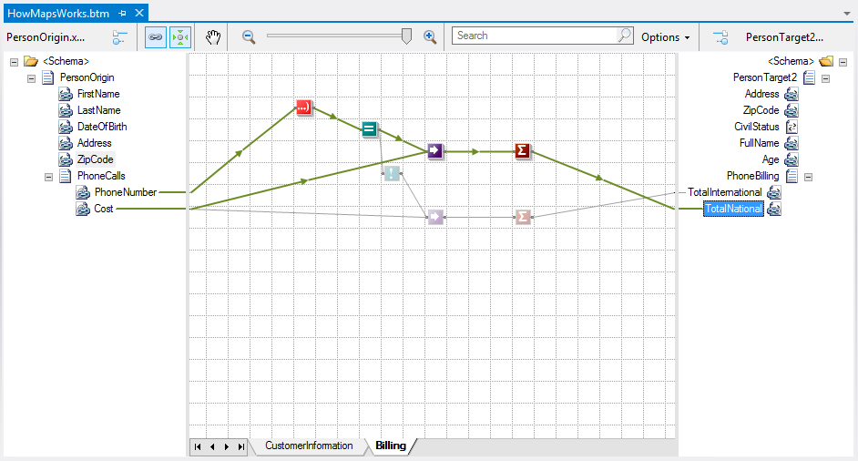
Deconstructing a map
<xsl:variable name="var:v12" select="userCSharp:InitCumulativeSum(1)" />
<xsl:for-each select="/s0:PersonOrigin/PhoneCalls">
<xsl:variable name="var:v13" select="string(@PhoneNumber)" />
<xsl:variable name="var:v14" select="userCSharp:StringLeft($var:v13 , &quot;4&quot;)" />
<xsl:variable name="var:v15" select="userCSharp:LogicalEq(string($var:v14) , &quot;+351&quot;)" />
<xsl:if test="string($var:v15)='true'">
<xsl:variable name="var:v16" select="@Cost" />
<xsl:variable name="var:v17" select="userCSharp:AddToCumulativeSum(1,string($var:v16),&quot;1000&quot;)" />
</xsl:if>
</xsl:for-each>
<xsl:variable name="var:v18" select="userCSharp:GetCumulativeSum(1)" />
<TotalNational>
<xsl:value-of select="$var:v18" />
</TotalNational>

Slide 21
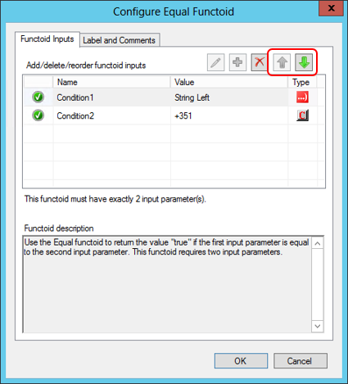
The order of links association
The order in which we perform the links between the elements from source to destination has a huge impact in the final result
This statement is true and false at the same time!
Impact of the order of links in functoids
The functoids require certain input parameters that can vary according to the functoid that we are using
Notes:
In fact the order with which we associate links (Drag&Drop) from the source to different destination elements is irrelevant, since the compiler, as previously explained, will process them in the correct order…
Except if we have to associate several links to the same functoid. In this cases the order in which the link association takes place is extremely important and can lead to unexpected results.
If we change the order in which the links are associated to the functoid, it will lead to mapping errors or unexpected results, according to the functoid used.

Slide 22
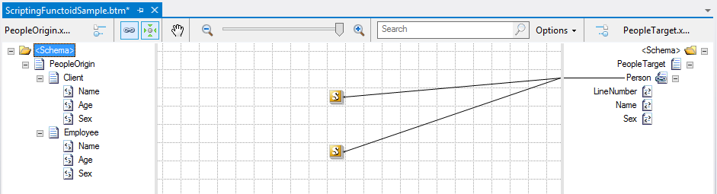
The sequence of links
The order in which we perform the links between the elements from source to destination has a huge impact in the final result
This statement is true and false at the same time!
Impact of the order of links in elements of the destination schema
If we change the order in which we associate the links on the same element in the destination schema we can also have an impact on the desired final result.
Notes:
Except if we have to associate several links to the same element or record. In this cases the order in which the link association takes place is extremely important and can lead to unexpected results.
If we change the order in which we associate the links on the same element in the destination schema we can also have an impact on the desired final result.
Unfortunately, when we associated different links in the same element, there is no way or place in the graphical editor where you can check the order of the association, for example, similarly to what happens with the functoids. The only way to verify the order in these cases is to inspect the XSLT generated code or testing the map.

Slide 23
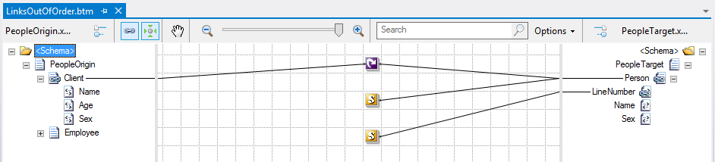
The exception to the rule of Link Sequence
int myCounter = 0;
public void IncrementCounter()
{
myCounter += 1;
}
public int ReturnCounter()
{
return myCounter;
}
Notes:
However there is one important exception to this rule of Link Sequence, especially when using custom scripts in recursive records or elements.
Once again, a good example of this scenario is the use of custom scripts to increment counters. We can illustrate this scenario by adding two Scripting Functoids to the map
We would expect that in the first cycle the result of the second script was the value "1", in the second cycle we obtained the value "2" and so on. However, if we test the map, we will see that the reality is different:

Slide 24
Best Practices
What best practices we must implement to improve developing performance

Slide 25
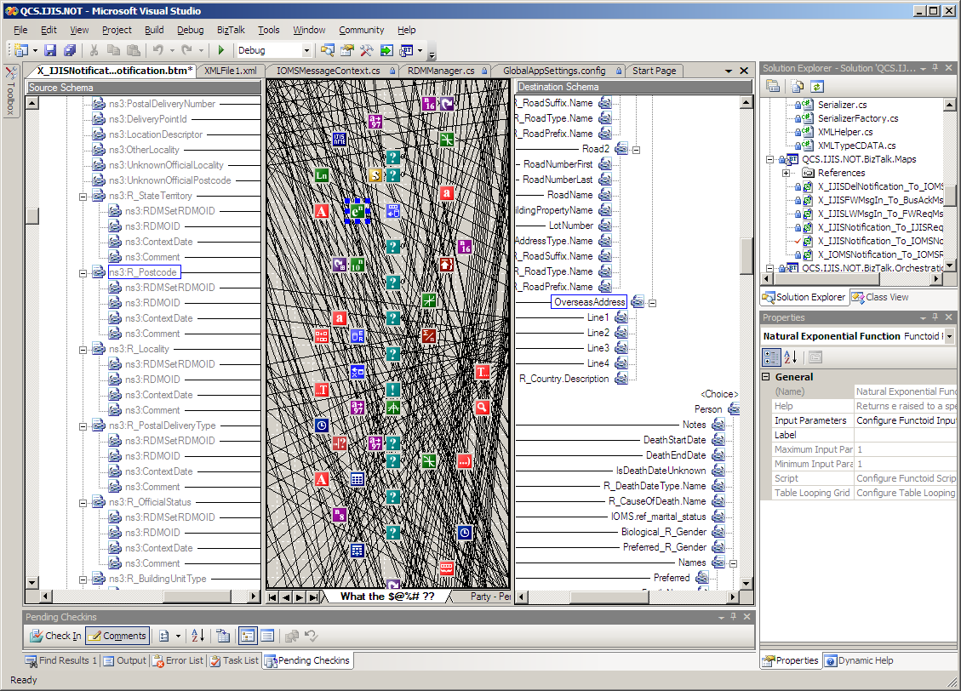
Challenges with large data transformations
Difficult to use with large schemas.
Hard to maintain complex maps
Hard to track relationships
No search capabilities
No cut/copy/paste or undo

Slide 26

Best Practices 1: Using Map Grid Pages
Use pages to reduce complexity of a map
Grid Pages
Grid Preview
Create unlimited different pages
Isolate different parts of a map
Work with different parts of a map separately
Must create connected functoids on the same layer
Source Schema
Destination Schema
Record
(..)
Order
PO
PO Number
Status
Date
ItemID
Item No
Qty
Quantity
UnitPrice
X
Order Status
Date
Total Price
Find and work with a portion of a large map
Page 1
Page 2
Page 3
Page 4
Notes:
Readability and Maintainability: For new and even for expert developers, or even when working with developers from other teams, using multiple grid pages will make the map easier to read and maintain if necessary make changes
Level of effort: by being easier to read and maintain you will reduce the development time.
Documentation: Using this technique will also help you to make a better map documentation, and sometimes this could be enough to self-documenting the map

Slide 27
Best Practices 1: Using Map Grid Pages
Pros:
Readability and Maintainability: For new and even for expert developers, or even when working with developers from other teams, using multiple grid pages will make the map easier to read and maintain if necessary make changes
Level of effort: by being easier to read and maintain you will reduce the development time.
Documentation: Using this technique will also help you to make a better map documentation, and sometimes this could be enough to self-documenting the map

Slide 28
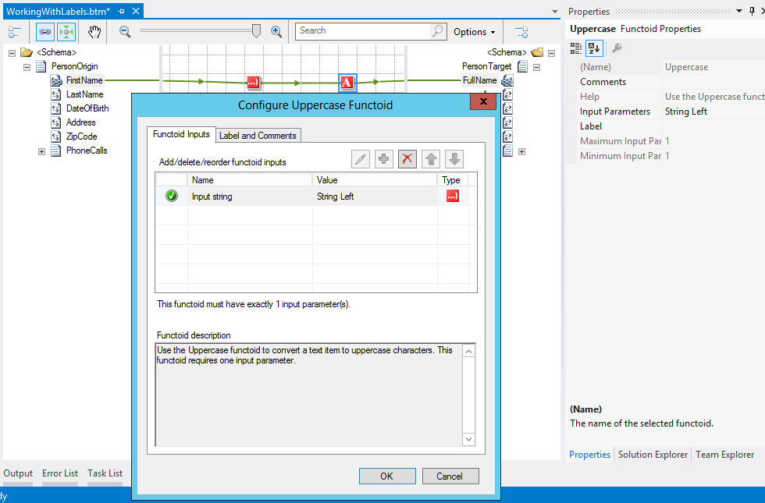
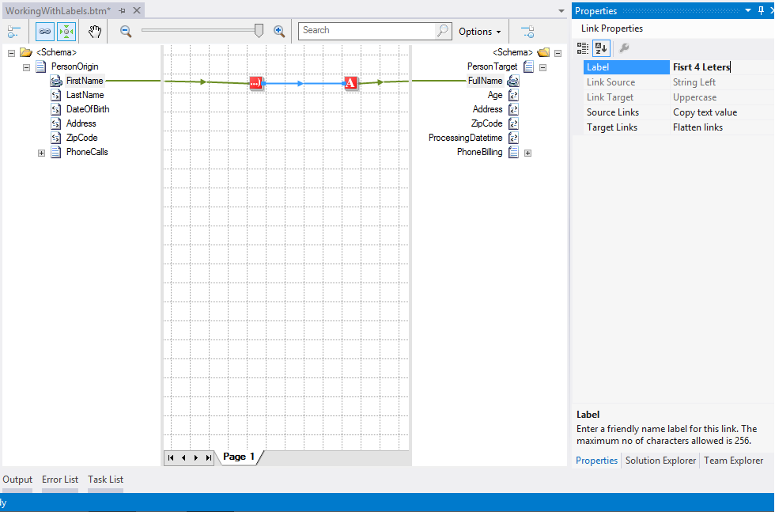
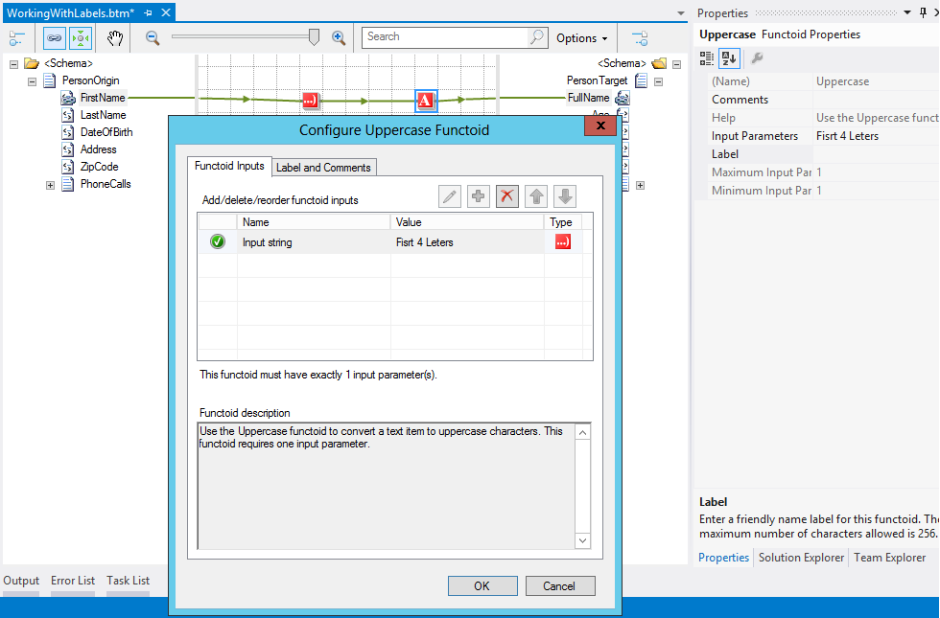
Best Practices 2: Using labels…
Notes:
Label and Comments tab
Label – Enter the new name. The maximum number of characters allowed is 256. If a string with more than 256 characters is specified, the first 256 characters are accepted and the rest are discarded.
Comments – Enter the comments for the functoid. The maximum number of characters allowed is 1024. If a string with more than 1024 characters is specified, the first 1024 characters are accepted and the rest are discarded.

Slide 29
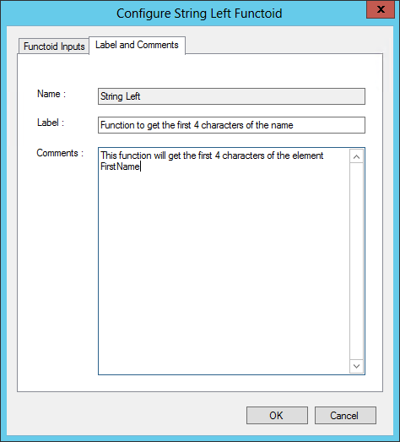
Best Practices 2: … and Comments
Labels
Comments
The maximum number of characters allowed is 256
The rest are discarded
The maximum number of characters allowed is 1024
The rest are discarded
Notes:
Label and Comments tab
Label – Enter the new name. The maximum number of characters allowed is 256. If a string with more than 256 characters is specified, the first 256 characters are accepted and the rest are discarded.
Comments – Enter the comments for the functoid. The maximum number of characters allowed is 1024. If a string with more than 1024 characters is specified, the first 1024 characters are accepted and the rest are discarded.

Slide 30
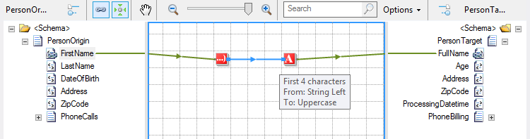
Best Practices 2: Using labels and Comments
Pros:
Readability and Maintainability: For new and even for expert developers, or even when working with developers from other teams, using multiple link labels will make the map easier and faster to read and maintain if necessary to make any changes.
Level of effort: again, by being easier to read and maintain you will reduce the development time.
Documentation: Using this technique will also help you to make a better map documentation
Notes:
We can make an analogy with C# code, if we are reading a function or a piece of code that doesn’t have any comment or inadequate nomenclature can become difficult and time consuming to understand, but if it’s well structured and commented the developer's life will be facilitated, same principals applies here

Slide 31
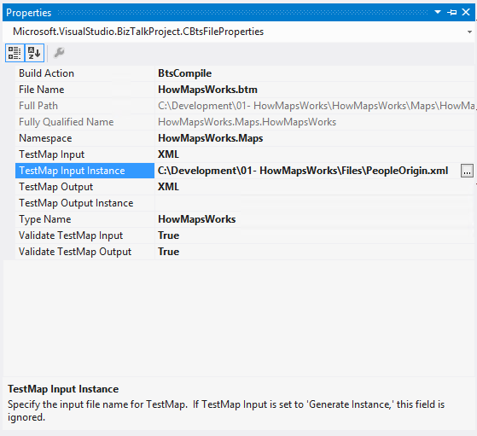
Best Practices 3: Testing should be a continuous process
Testing should be a continuous process as you build your map, not only at the end of development, but when necessary or when an important mapping block is complete

Slide 32
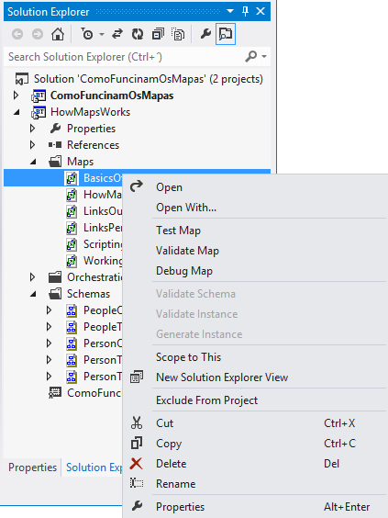
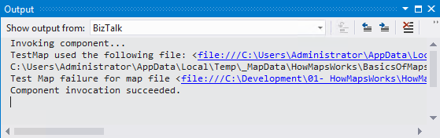
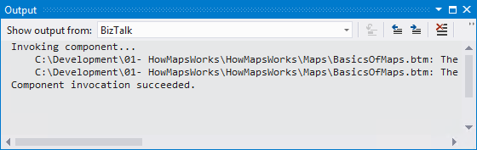
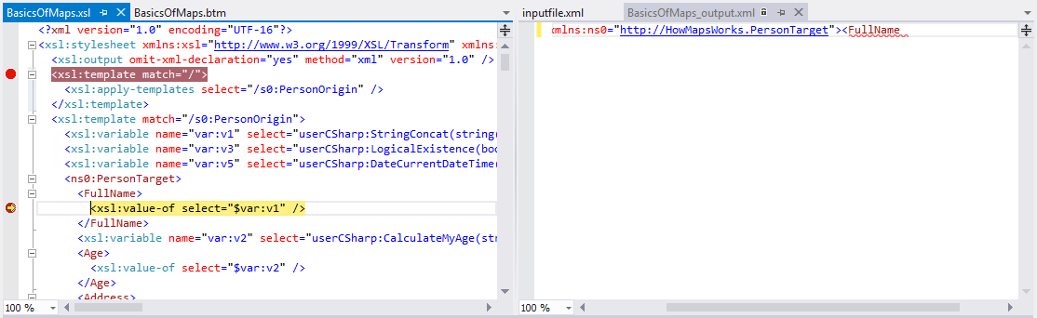
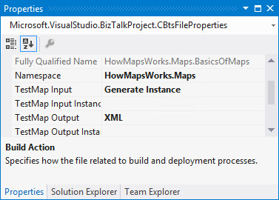
Validating, Testing and Debugging a Map
Notes:
Validating a Map
Before a map is deployed, it should be tested to ensure that the resulting message contains the desired results. The BizTalk Mapper provides the tools for validating a map and testing a map with sample data, much as can be done with schemas
Testing a Map
Before you can test a map, you need to specify the type and location of an instance message to be used for testing. Several properties need to be configured, which are set in the .NET properties for the map. The .NET properties, as distinguished from the BizTalk properties, are accessed by right-clicking the map in Solution Explorer, and then clicking Properties.
Validate TestMap Input. Specifies that the input message should be validated.
Validate TestMap Output. Specifies that the output message should be validated.
TestMap Input Instance. This is the message that you will use as the source message instance for the map. This instance should be validated using the schema validation steps described in Module 2, “Creating Schemas.”
TestMap Input. This specifies the format of the test message (XML, Native, or Generated Instance). Native specifies that Visual Studio must convert the input file from flat file format to XML before executing the map.
TestMap Output. This specifies the format of the test message (XML or Native).
TestMap Output Instance. Specifies the file location for the message to be written to. If the file exists in the same location, it will be overwritten.
After configuring the test properties, right-click the map in Solution Explorer, and then click Test Map. A link to the input and output message will be shown.

Slide 33
Best Practices 4: Built-in and Custom Functoids vs Scripting Functoid
Scripting Functoid
Allows you to execute custom code
Can execute custom script: C# .NET / VB.NET / JScript.NET / XSLT / XSLT Call Template
But we need to rewrite over and over again!
Reasons to develop custom or use built-in functoids:
They are reusable
More easy to read (visually on the map grid)
Careful: All functoids must have a unique ID in order for the runtime to distinguish them.
The ID is an integer and all IDs below 10000 are reserved for Microsoft use.
Notes:
The advantages of using the built-in functoids:
Overview: Using the functoids can give a developer a better overview of what functionality a map provides, and sometimes also provides a good overview for not developers also. Whereas Scripting Functoids with custom XSLT needs to be read by a developer to be able to understand what is happening.
Maintainability: A BizTalk developer knows about maps and functoids without necessarily having to know or be an expert in XSLT (although I find extremely important). By staying with the functoids you give a BizTalk developer, new, expert or even to external team members, the best possible opportunity to understand a new map and for them to maintain. This reason is valid if you don’t use very complex functoid chain and use best practices in how to organize and document your maps.
Level of effort: by being easier to read and maintain you will reduce the development time.
Disadvantages or precautions to take when using built-in functoids:
Limit of operations scope: Although BizTalk Server provides many functoids to support a range of diverse operations, we are limited to the number of existing operations.
The advantages of using Scripting Functoid:
Performance. It seems rather obvious that automatically generated XSLT can’t perform as well as custom XSLT. So if you really need high performance, use your own XSLT.
Maintainability. If you remember I used this argument also in the built-in functoids as well with conditions and the same appends here if you use Scripting Functoids (C# or XSLT) to simplify the complex functoid chain or to be more reusable, then you are improving the Readability of the map and therefore enhance the maintaining process.
Everything is possible: Basically you can do what you want. Use different script types or combine them to solve your transformation problems.
Disadvantages or precautions to take when using Scripting Functoids:
Reuse: We need to rewrite over and over again the code!
Compiler limitations: When you create a script, for example a C# function, remember to give it a correct name because all scripts with the same name are treated as one by the compiler regardless of whether the code is equal or not.
Support: If you are thinking in use XSLT language: it supports only XSLT 1.0 (XSLT 2.0 not supported).

Slide 34
Best Practices 4: Built-in and Custom Functoids vs Scripting Functoid
How we can decide what to use:
Can this transformation be reused several times in this map or can be reused in several maps?
Will this transformation cost me several hours of work?
Will this transformation be easier to read and maintain?
Is this approach which that will bring me more profits?
Notes:
An alternative to wrap repeated transformation rule logic in custom functoids is to put this rules in an external assembly and call this assembly through a Scripting functoid.
The advantages of using External Assemblies:
Maintenance: If you have an external assembly with your transformation rule logic, then you can easily maintain it (making fixes or updates) without having to update and redeploy the maps. This means that you can change the way all those maps work by modifying and replacing the assembly in the global assembly cache (GAC).
Level of effort: They are reusable. Because the .dll containing the transformation rule logics is deployed into the Global Assembly Cache (GAC), you can reference them in your project you can reference and use this functionality in your Scripting Functoids as often you want and again considerably simplifying the development task at hand.
Development: You can have several operations inside a single .dll and you can easily implement version control and have different versions running side-by-side.
Disadvantages or precautions to take when using External Assemblies:
Overview: Because they are encapsulated inside Scripting Functoids, is more difficult to read visually on the map grid compared with built-in functoids or custom functoids.
Compiler limitations: By register the assembly in the GAC will make your function available to BizTalk, but the function will not be available to the map until you add the .dll as a reference to your mapping project. So you need to reference your assembly in every single project that you want to use.
Development: it requires experience with .NET Programming and since there may be multiple instances of a map running at the same time, you have to ensure that the code used in an assembly called from a Scripting functoid must be thread safe.

Slide 35
Best Practices 4: Built-in and Custom Functoids vs Scripting Functoid
Basic guidelines to decide what to use:
First guideline: I prefer to use the built-in functoids whenever possible unless is not possible to accomplished or the functoid chain becomes too complex to unravel easily.
Second guideline: I turn to custom scripting functoids, XSLT or C#, only when I cannot solve my problem with the built-in functoids or is too complex to accomplish using built-in functoids.
Third guideline: If is a repeated transformation rule that you can use in several maps you then you should use or create a custom functoid to solve this problem.
Notes:
Second rule: A good example for using scripting functoids is to solve grouping problems, complex transformations rules with multiple elements or if/else decisions inside cycles.

Slide 36
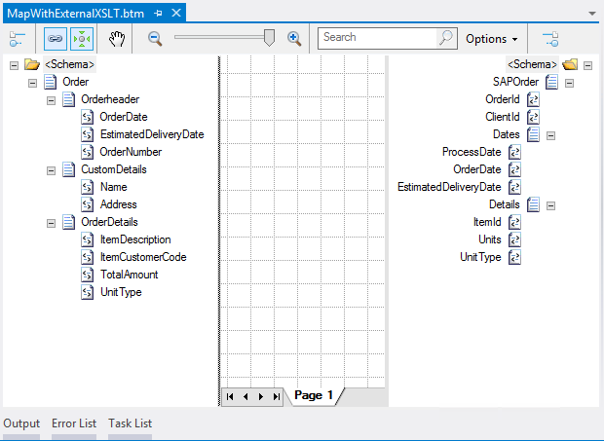
Best Practices 5: External Custom XSLT vs BizTalk Mapper
Pros:
Direct XSLT is more powerful, fewer limitations than the BizTalk Mapper
Improved performance
XSLT file can be developed separately and hosted in a BizTalk map
Cons:
Not quite as intuitive
Functoids are more easy to read (visually on the map grid)
Requires “geeky” coding skills
Loss of visual map representation
Notes:
The advantages of using External Custom XSLT file:
Development: XSLT file can be developed separately and hosted in a BizTalk map.
Disadvantages when using External Custom XSLT file:
Level of effort: Not quite as intuitive, Functoids are more easy to read visually on the map grid and therefore Requires “geeky” coding skills
Overview: You loss of visual map representation.
Some people also mention that using External Custom XSLT file can also improve:
Performance and Compiler limitations: Direct XSLT is more powerful, fewer limitations than the BizTalk Mapper and will definite will improved performance in complex transformation rules.
I don’t agree because you can also implement use custom XSLT and use this approach.

Slide 37
Best Practices 6: Reviewing the XSLT
Inspecting the XSLT generated by the compiler provides insight into how the map functions
Also provides another debugging option
In Solution Explorer, right-click *.btm file and select “Validate Map”
Link to generated XSLT shown in Output window

Slide 38
Common mapper problems and solutions
Some of the best ways to address some of your needs within the context of message transformation

Slide 39
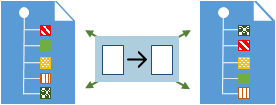
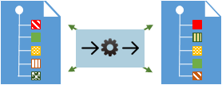
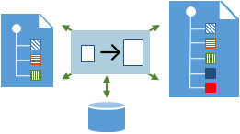
BizTalk Mapper Patterns
DIRECT TRANSLATION PATTERN
How can we transform the incoming message if the target message have a different semantic representation?
DATA TRANSLATION PATTERN
How can we transform the incoming message if the target message have a different data formats?
CONTENT ENRICHER PATTERN
How can we transform the incoming message if the message originator does not have all the required data items available expected by the target message?

Slide 40
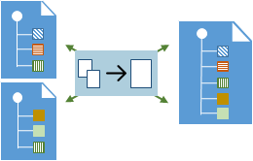
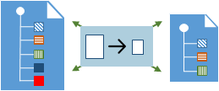
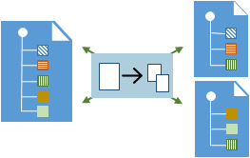
BizTalk Mapper Patterns
AGGREGATOR PATTERN
How do we combine the results of individual, but related messages, so that they can be processed as a whole to generate the target message?
CONTENT FILTER PATTERN (Data Cleaning Pattern)
How can we transform the incoming message if the target message requires less information that the originator message?
SPLITTER PATTERN
How can we process an incoming message into a series of outgoing messages so that they can be sent to multiple recipient and processed in different ways?

Slide 41
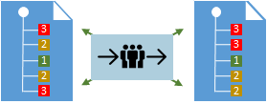
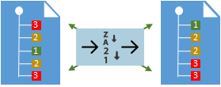
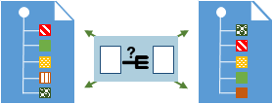
BizTalk Mapper Patterns
GROUPING PATTERN
How can we transform the incoming message if the target message requires that the body of the message must be delivered grouped in a certain way?
SORTING PATTERN
How can we transform the incoming message if the target message requires that the body of the message must be delivered in a certain order?
CONDITIONAL PATTERN
How can we transform the incoming message if the target message requires that the data items available in message originator can be passed according on a set of conditions?

Slide 42
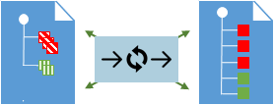
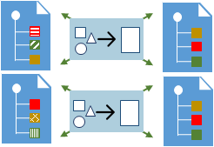
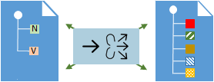
BizTalk Mapper Patterns
LOOPING PATTERN
How can we transform the incoming message if the target and/or originator message have a complex and recursive structures? How can we apply a set of common procedures to be apply many times?
CANONICAL DATA MODEL PATTERN
How do you process messages that are semantically equivalent, but arrive in a different format? And How can you minimize dependencies when integrating applications that use different data formats?
NAME-VALUE TRANSFORMATION PATTERN
How can we transform the incoming message if the target message requires a name–value pair (NVP) structure? Or if the target message requires a hierarchical schema but the originator message have a NVP structure?

Slide 43
Custom XSLT
Functoids
Inspect
Let’s have fun… Demos
BizTalk Mapper Patterns specifying best practices and some of the best ways to address some of your needs within the context of message transformation.
Notes:
02- JoinMultipleMessages
03- HowToSendOrchestrationVariablesIntoMaps
04- WorkingWithConstantValues
05- MappingWorkingWithMultipleOutputMessages
06 – WorkingWithConditions
07- BizTalkMapperIFinLoppingRecord
08- MuenchianGroupingSortingWithoutLosingMapFunctionalitie
10- SandroPereira.MappingToNameValueRecord
11- SandroPereira.NameValueToHierarchical
CommonMappingLogicConstructs

Slide 44
Questions?

Slide 45
Thanks
sandro.pereira@devscope.net
linkedin.com/in/sandropereira
@sandro_asp
sandroaspbiztalkblog.wordpress.com
+351 223 751 350
www.devscope.net

